Slide 1
Fascioliasis
Liver Flucke, Bottle Jaw

Slide 2
Definition:
It is an acute or chronic disease of ruminants mainly, caused by fasciola spp.,characterized by sudden death, bottle jaw, emaciation and chronic digestive disturbance.
Etiology:
Fasciola hepatica and F. gigantica
Predisposing factors:
Common in law laying swampy area
In area subjected to frequent flood-irrigation
Stress factors as pregnancy and parturition

Slide 3
Epidemiology:
The disease is widely distributed in many countries and endemic in Egypt.
Animal Susceptible: it is primary disease of ruminants but may be affect others as horse, camel, deer, pigs, rabbits, human, dog and cat
Seasonal incidence:
Intermediate host snails is L. cauillaudi breeding capacity increase in April month and L stegnalis with end barseem season (autumn and early winter)

Slide 4
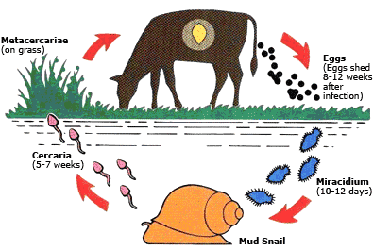
Life cycle
Larvae free from cyst and penetrate duodenum and wandering through abdominal cavity into liver and change to adult after 8-10 w
Ingestion
Live in pasture for upto 6-12m
Sporocyst Redia cercaria
Prenatal infection may occurs where migrating immature larvae infect fetus in uterus and adult fluke may be recovered from calves less than 6 w age

Slide 5
Pathogenesis
Acute hepatic fascioliasis:
Sudden death due to massive invasion of liver by young fluke with acute hepatic insufficient and hemorrhage in peritoneal cavity
Chronic form
Develop slowly due to mature liver fluke in bile duct which cause cholangitis, billiary obstruction, destruction of hepatic tissue, fibrosis and hemorrhagic anemia

Slide 6
Clinical signs
IP variable, Morbidity is high 90% and mortality is low
Acute form:
It is rare in a cattle and buffaloes and occurs in young ruminants (sheep and calves) especially well fattened one
Decrease of appetite, dullness and weakness
pale mm and edema in conjunctiva, enlargement in liver and ascites
Recumbence and sudden death within 48 h with blood stain discharge passage from nostril and anus

Slide 7
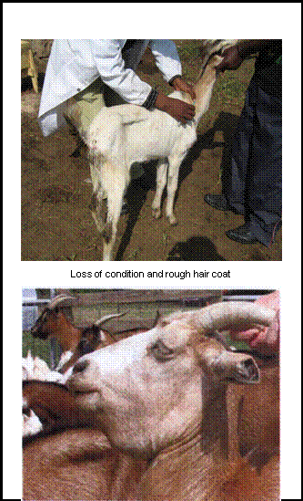
Chronic form:
It is more prolonged due to ingestion of few number of cercaria
Sheep
Decrease appetite,
loss weight, submandibular
edema (bottle jaw), pale and
icteric mm
Diarrhea and wool shedding
Anemia and hepatic
malfunction

Slide 8
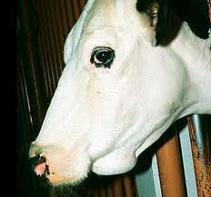
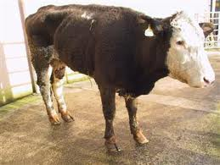
Cattle and buffaloes
Anorexia and reduce growth rate, loss of weight and milk production
Chronic diarrhea or faeces may be normal or hard
Bottle jaw, jugular pulsation and icteric mm

Slide 9
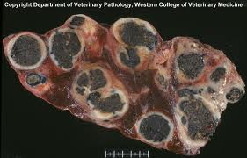
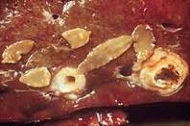
Postmortem lesions:
Acute form
Congested, swollen and damaged liver
Liver capsule showed perforation with subcapsular hemorrhage
Small liver fluke can be seen on slicing apiece of liver
Chronic form
Large leaf liver flukes present in bile duct and protruded above liver surface
Calcification of bile ducts wall
Liver parenchyma is extensively fibrosed

Slide 11
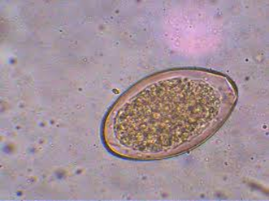
Diagnosis
History
Field diagnosis based on emaciation, diarrhea, bottle jaw, sudden death and fasciolin test.
Postmortem lesion
Laboratory diagnosis
Samples: faeces, liver, blood and serum
Fecal examination by direct and sedimentation
Oval, operculated greenish yellow in color and embryonic cell well demarcated
Serum biochemical changes: Hypoproteinemia due to increase protein leakage into the gut
Hematological changes: PCV, Hb and RBCs may be decrease with Sever normochromic anemia, and hypochromic anemia in chronic form with eosinophilia
Histopathology of liver to detect liver degenerative changes
Slicing apiece of liver thinly and put in water with shaking then permitting the fluke to settle to the bottom, naked exam. Showed immature worms of ¼ inch length

Slide 12
Differential diagnosis
Acute form: all diseases cause sudden death as anthrax, enterotoxaemia and acute pasturellosis
Chronic form: it is confused with all affection characterized with anemia and diarrhea as John's disease, Paramphistomiasis, intestinal helminthes and nutritional deficiency (as copper and cobalt)

Slide 13
Treatment:
Indication, dose, route | Active principle | Trade Name
For chronic and acute older than 4 weeks in sheep and 8 weeks in cattle in a dose 1 mg/kg (1 ml/75 kg) for cattle and 3 mg/kg (3 ml/75 kg) for sheep, S/C | Rafoxanide | Ranide®
The same as previous in a dose 1 ml/25 kg, S/C | Rafoxanide | Rafoxanide®
Highly effective against mature but less effective against immature flukes in a dose 10 mg/kg, S/C | Nitroxynil | Fasciolid® Dovenix®
Effective against adult fluke and 8 week old immature flukes in a dose 1 ml/50 kg, S/C | Clorsulon 10% and ivermectin 1% | Ivomec supper®
It is highly efficient against fascioliasis in cattle, sheep, and horses in a dose 12 mg/kg in cattle and 10 mg/kg in sheep, orally | Trichalbendazole | Fasenix® tablet

Slide 14
Control
Treatment of infected animals
Hygienic measurements
Infected pasture should not use for grazing
Wet pasture or floody areas are avoided
Regular removing of manure
Snails control
Application of copper sulfate 1% , used after mixing of 1-2 parts of copper sulfate + 2-4 parts of sand and spread on stagnant water

